Slide 1
Trust & Identity Services
SAFIRE & ORCID
Guy Halse
https://orcid.org/0000-0002-9388-8592

Slide 3
ORCID iDs among SEALS
Number of ORCID iDs
Adjusted for enrolment
As at 15 Oct 2018
Notes:
Statistics based on ORCID iDs with institutional email addresses; enrolment counts from 2016 DHET HEMIS data

Slide 4
ORCID Membership
Individuals register for ORCID iDs
Institutions become ORCID members
ORCID members get benefits, primarily around integrating their own systems into ORCID. They also get access to reports.
ORCID membership helps fund ORCID, so that it can remain free for individuals (and free from advertising)

Slide 5
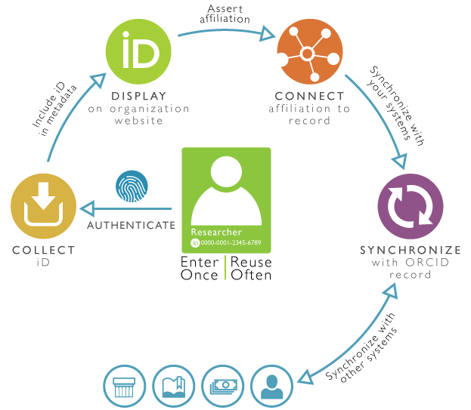
ORCID Integrations
Notes:
ORCID virtuous cycle: collect & connect. Three main integrations we’ve helped South African ORCID members with in 2018

Slide 6
ORCID Consortium Model
ORCID consortiums offer members
local, in-country support for integrations
tiered discounts
the larger a consortium is, the cheaper membership becomes
national representation in ORCID forums
Currently 18 ORCID consortiums worldwide
Consortiums come into existence for a variety of different reasons; with different core focuses; and different funding models
https://orcid.org/consortia

Slide 7
South African ORCID Consortium
Operated by TENET at the behest of institutions
Open to universities and non-profits
not limited to TENET beneficiaries
Currently has 13 members
Strong focus on reducing costs of ORCID membership
passes on ORCID membership costs directly
nominal consortium lead fee for TENET beneficiaries
https://orcid.org/members/001G000001zVNxWIAW-tenet
Notes:
As at 18 October 2018

Slide 9
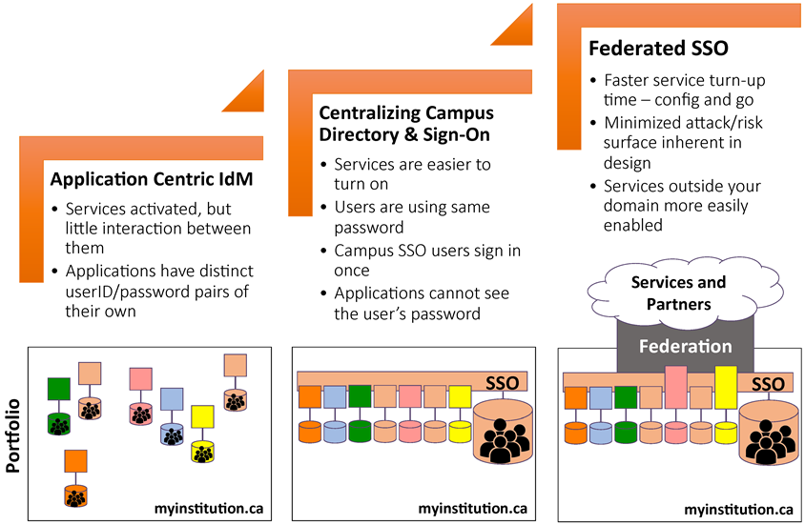
Evolution of Identity Techniques
Notes:
Source: https://collaboration.canarie.ca/elgg/file/download/3173

Slide 10
SAFIRE
Academic identity federation for South Africa
18 participants
12 identity providers
12 service providers (+ 2122 eduGAIN)
178 AuthN/day
Member of eduGAIN since February 2017
Notes:
Statistics from SLARG meeting, August 2018 – adjusted to include two new identity providers that have joined

Slide 11
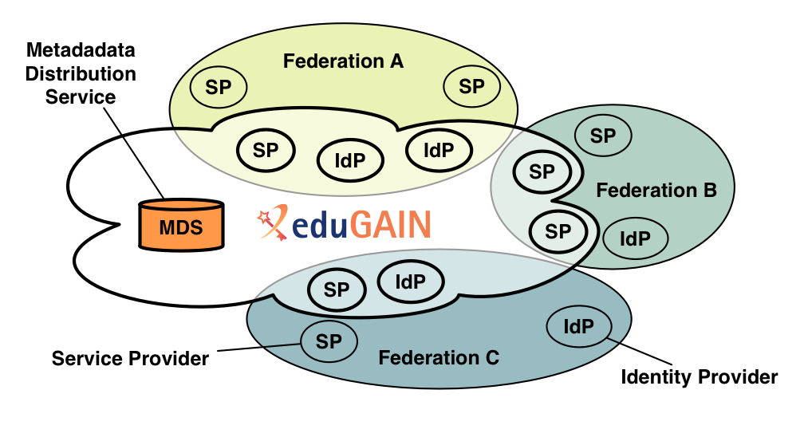
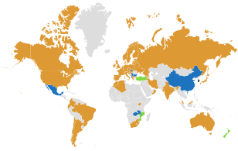
eduGAIN
“federation of federations”
https://www.geant.org/Services/Trust_identity_and_security/eduGAIN/Pages/About-eduGAIN.aspx
Notes:
Map as at 18 October 2018, per edugain.org

Slide 12
What are people doing with SAFIRE?
Oct ’17 – Apr ‘18
Notes:
Stats collected from Oct ’17-Apr ‘18 because of how SimpleSAMLphp collates them. We’ll look at changing this.
Interesting to see DIRSA on there ☺

Slide 13
Why participate?
Identity Provider
Service Provider
Global single sign-on
Existing integrations with major library information providers
Awareness of POPIA and GDPR
One integration to access many institutions
More accurate user information
Reduced support costs
Better identity management lifecycle
https://safire.ac.za/participants/idp/why-join/
https://safire.ac.za/participants/sp/why-join/

Slide 14
Single Sign-On in action
Notes:
Recorded 18 October 2018

Slide 15
How can we help you?

